Slide 1
Selecting the correct size
of Sagittal Appliance

Slide 2
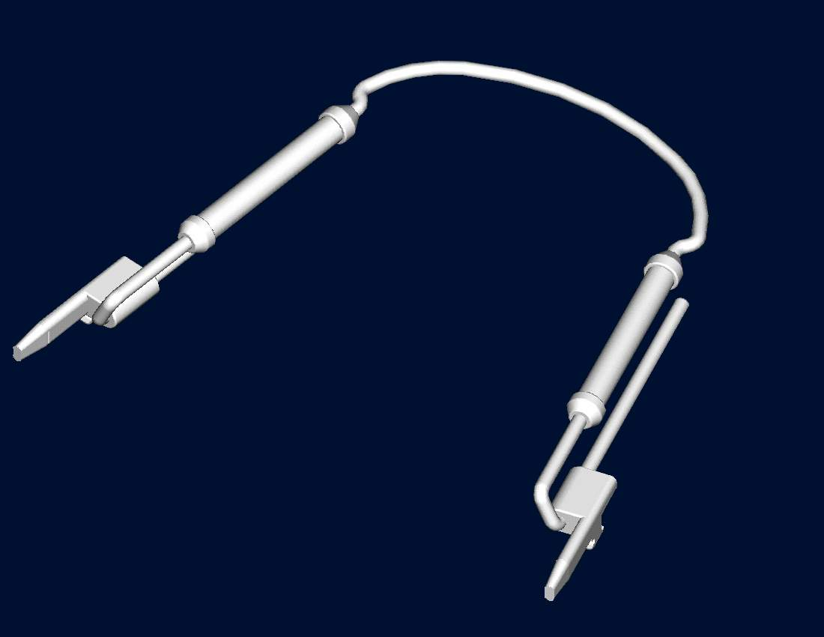
TransForce ^{®2} Sagittal

Slide 3
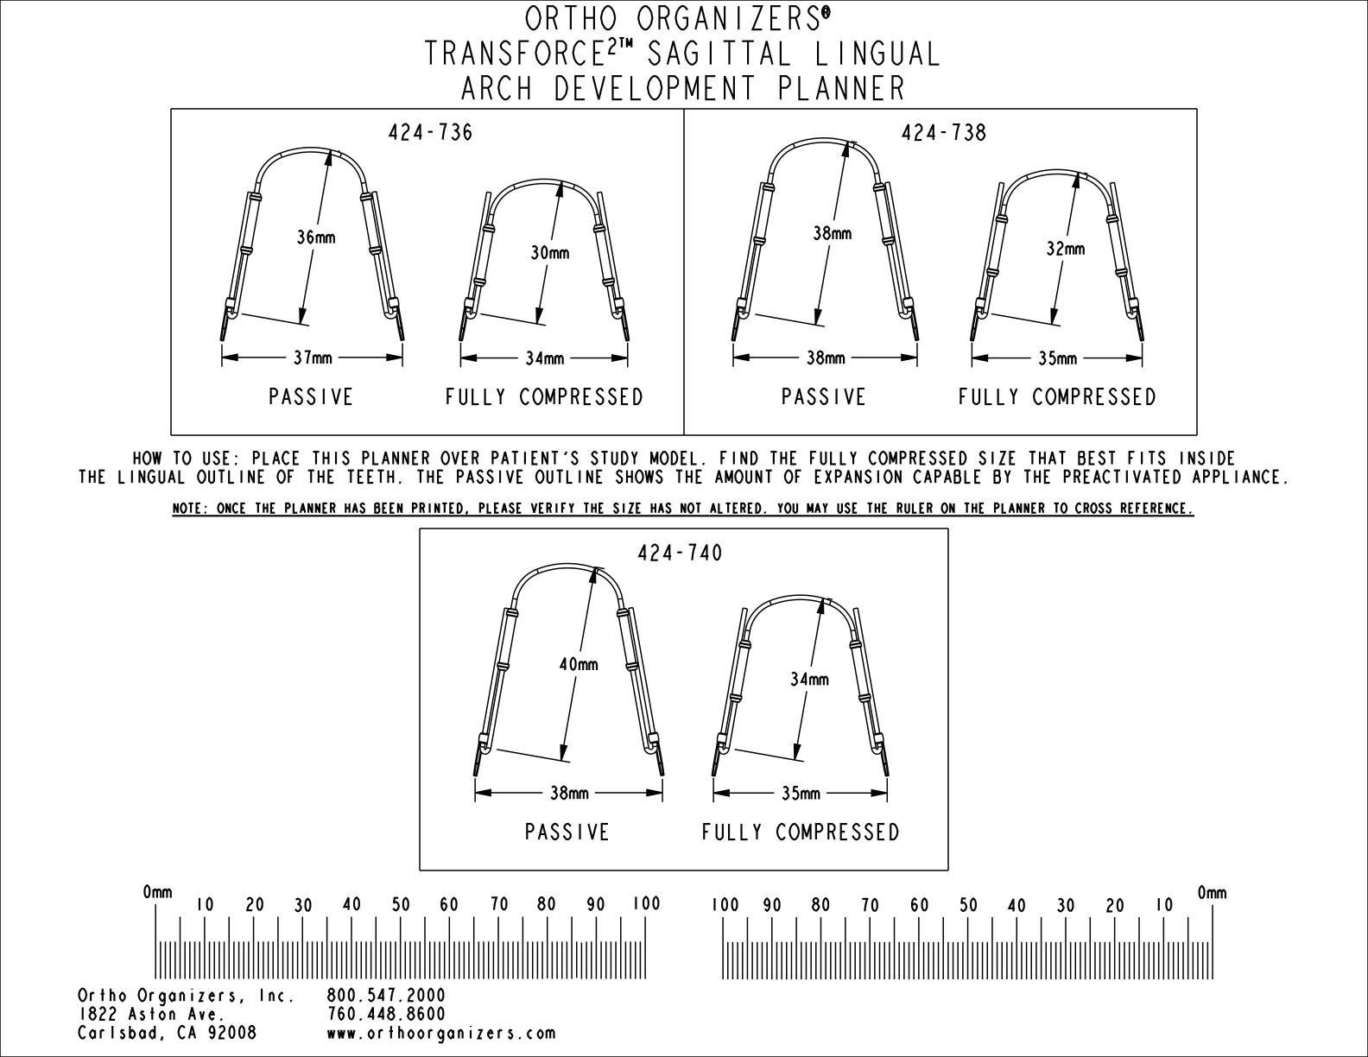

Slide 4
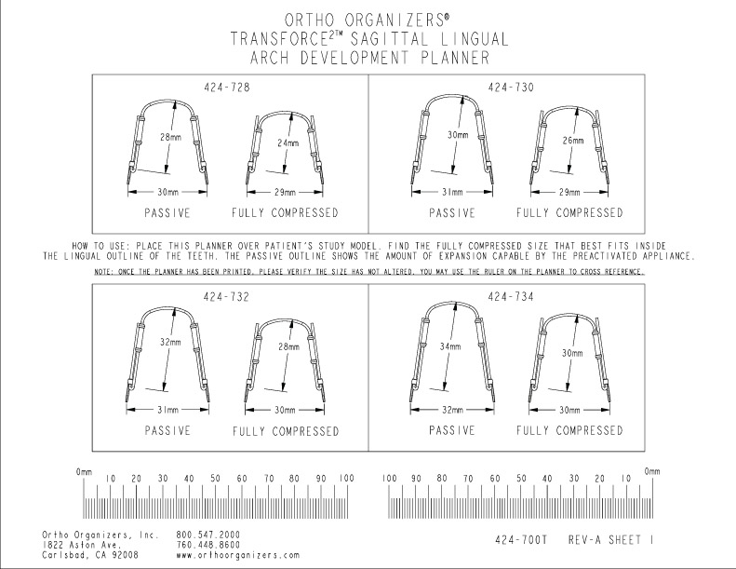

Slide 5
<---
Upper
6 mm activation
--->
Lower
4 mm Activation

Slide 6
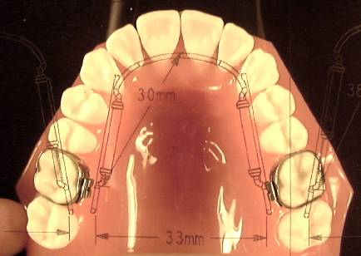
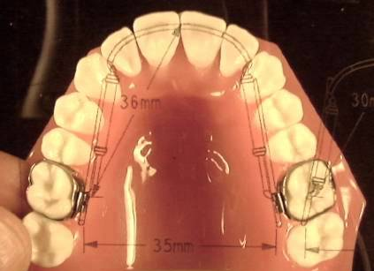
.
<---
Fully Compressed Upper
Size 30
.
--->
Fully Expanded Upper
Size 36
6 mm Activation

Slide 7
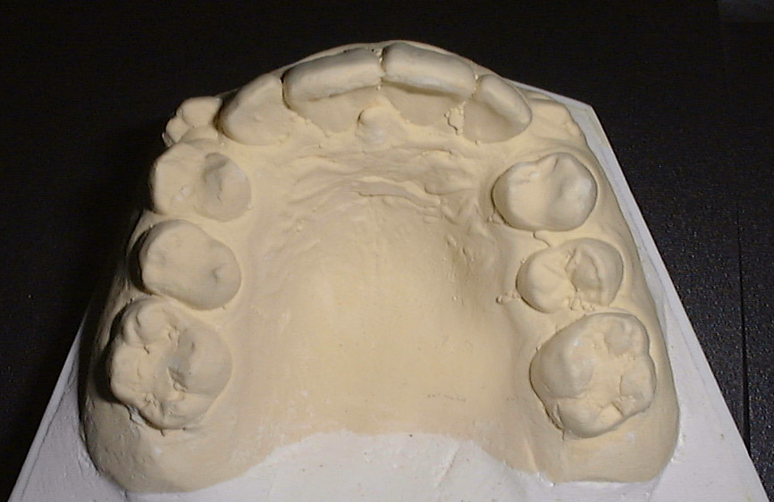
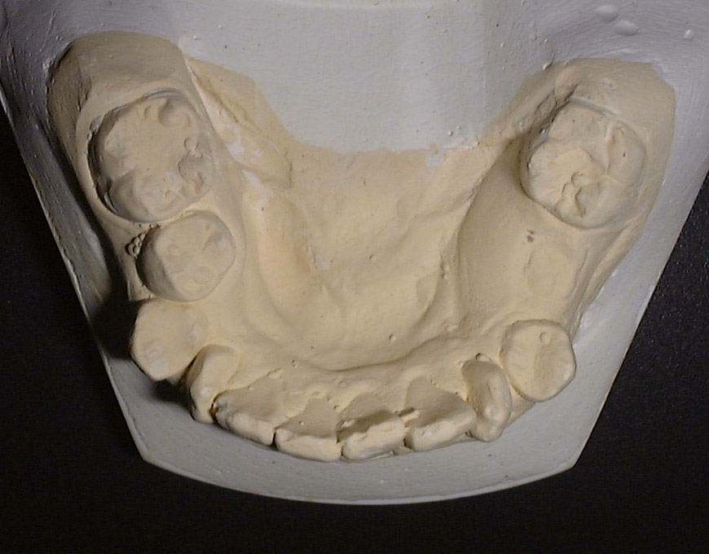
.
Measure Arch Length
Upper
6 mm activation
Resolves 12 mm crowding
.
.
<---
.
.
--->
Lower
4 mm activation
Resolves 8 mm crowding
.

Slide 8
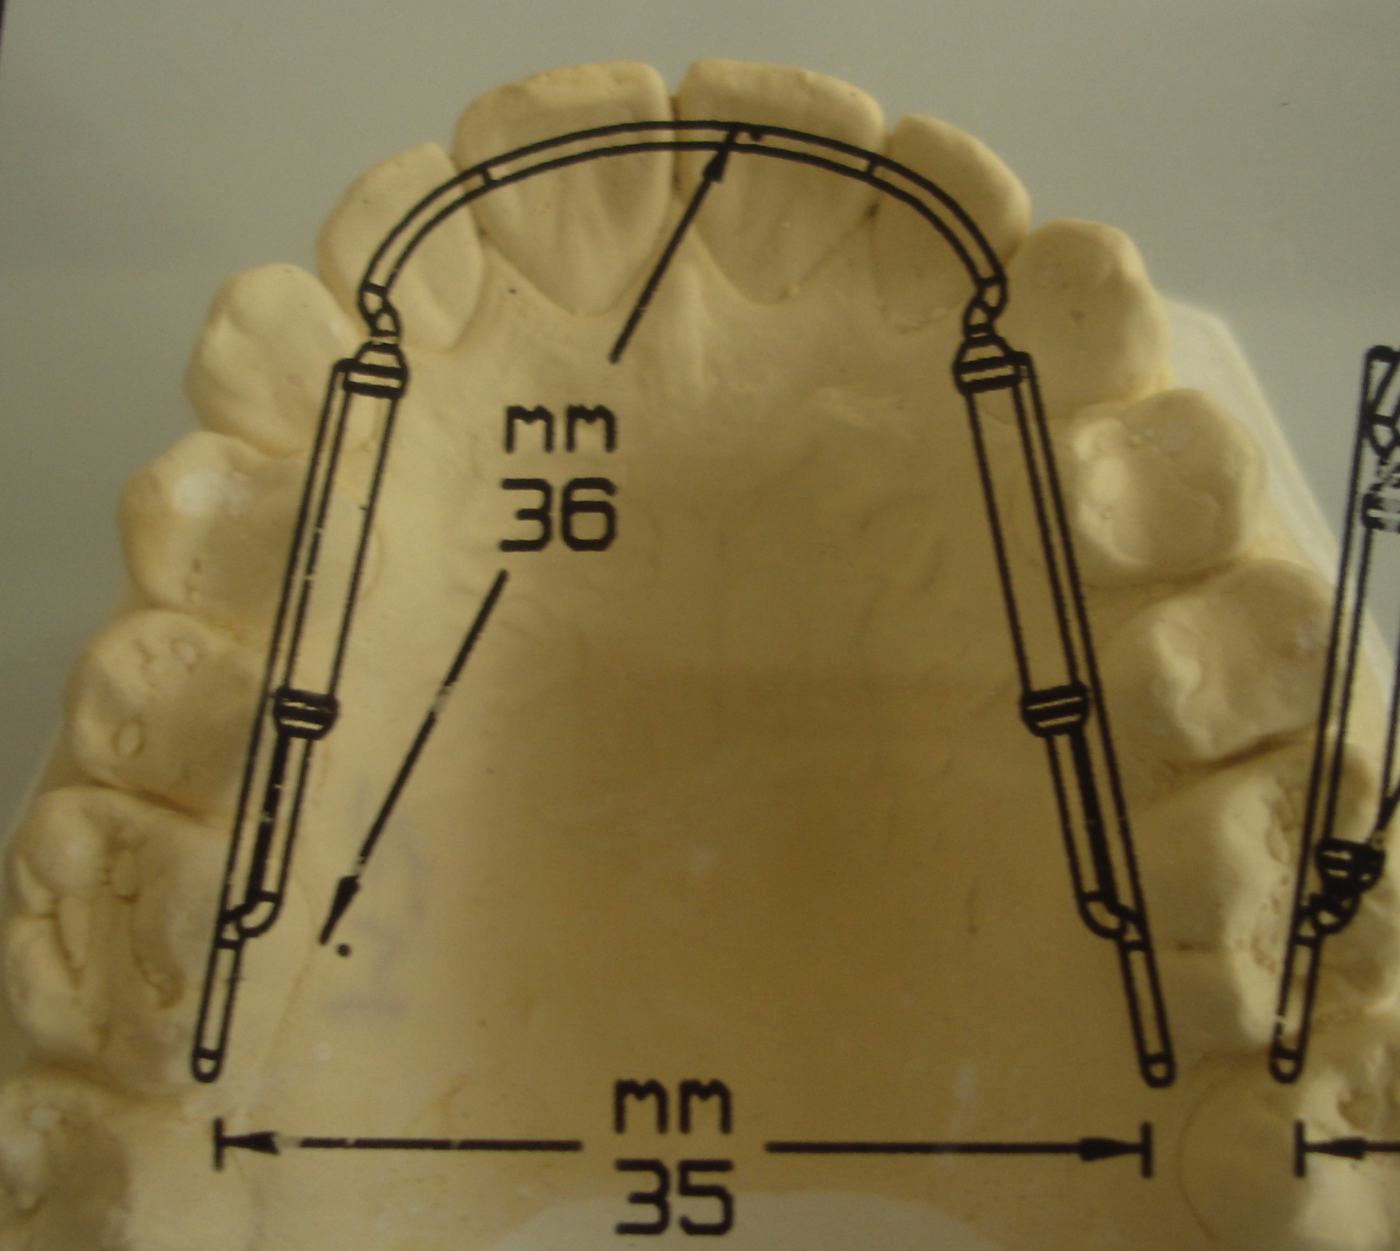
Using the template
.
.
Before
&
After

Slide 9
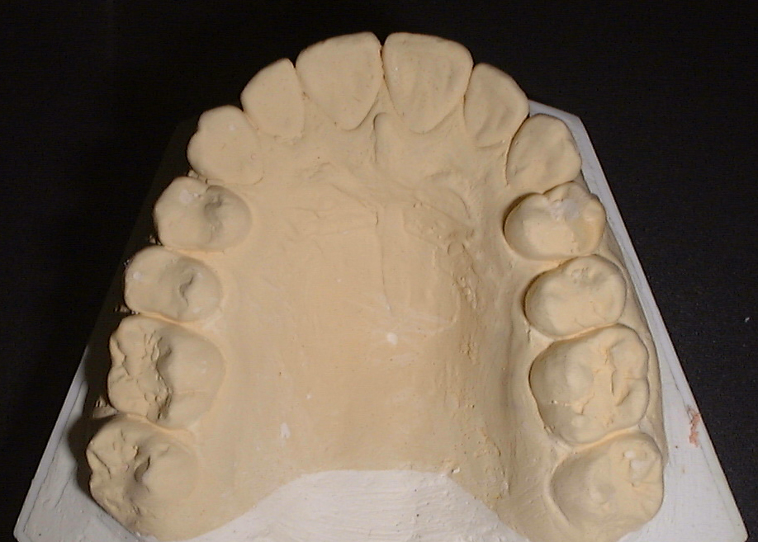
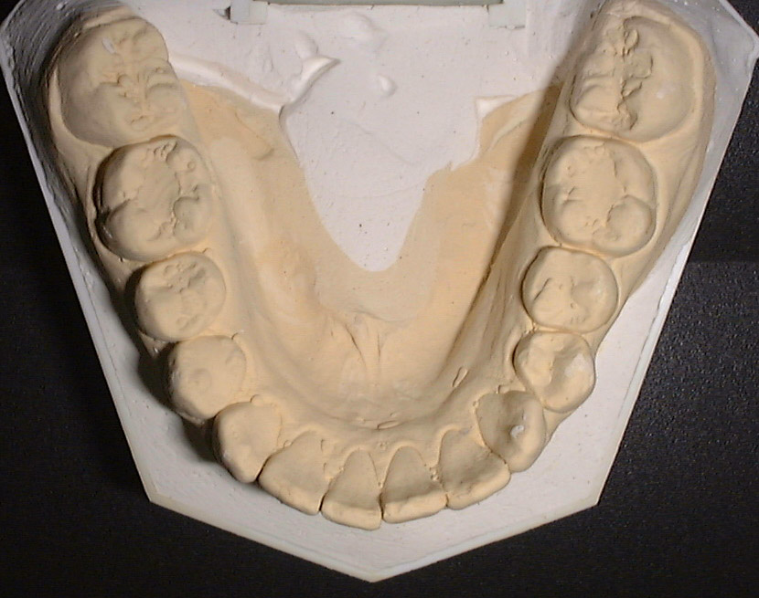
.
.
.

Slide 10
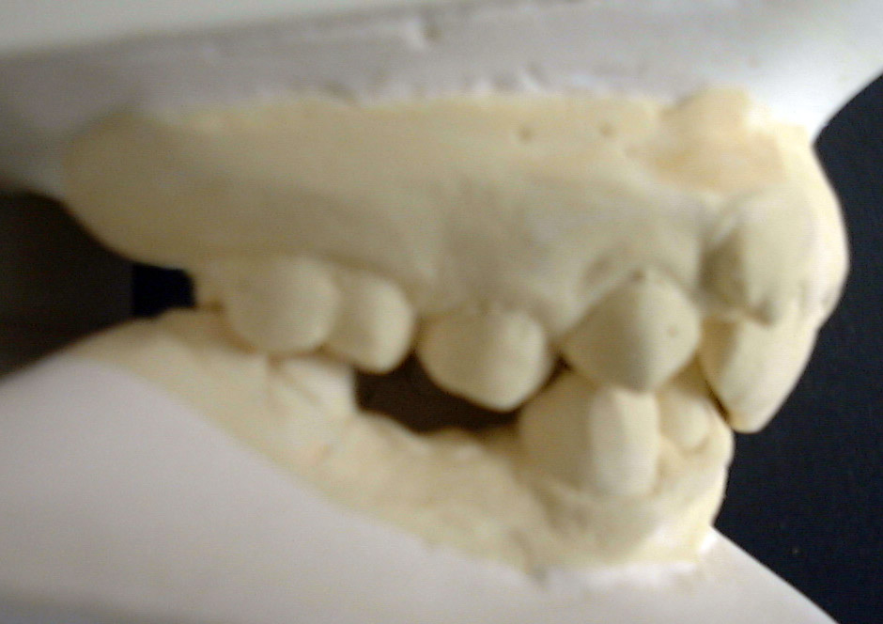
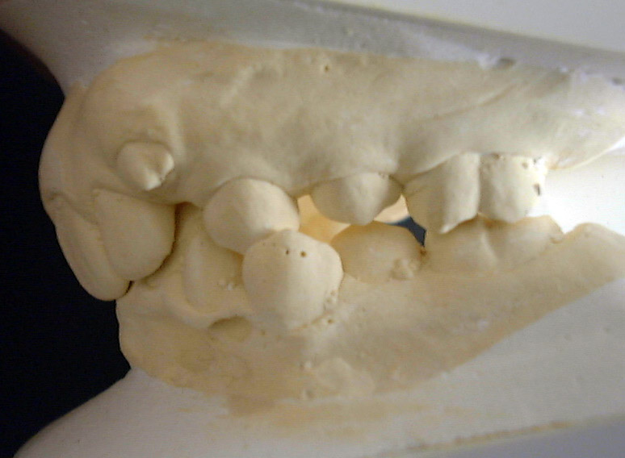
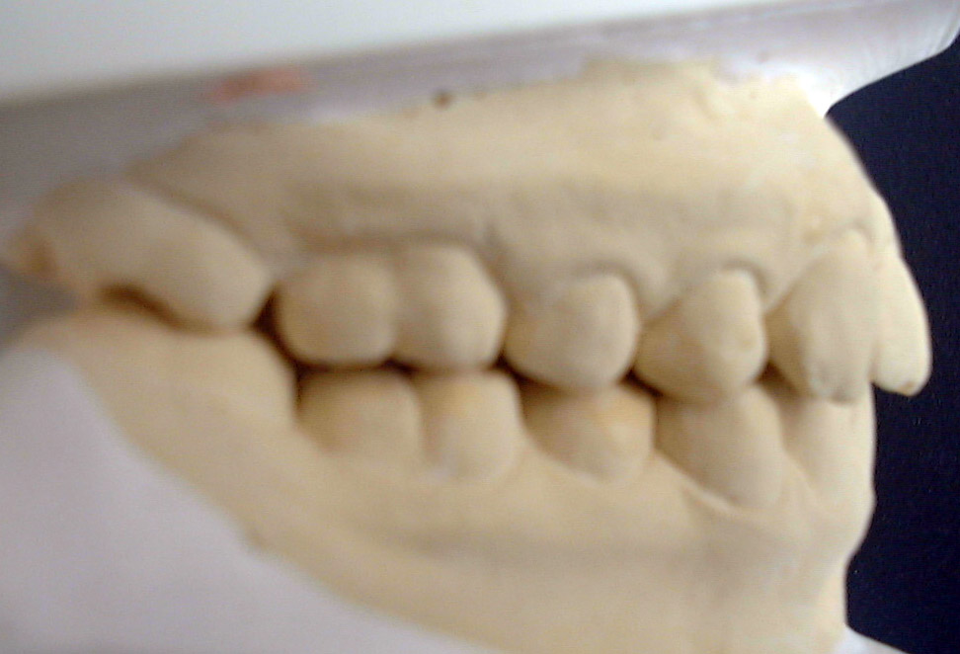
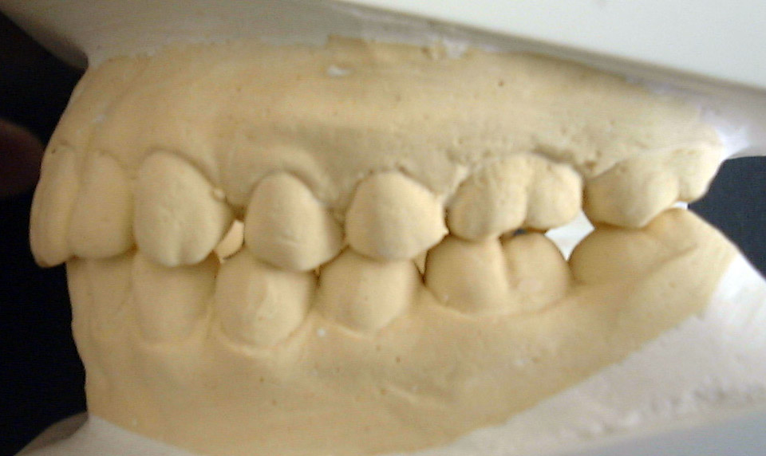
.
.
.

Slide 11
Guidelines For Case Selection
Sagittal Appliance

Slide 12
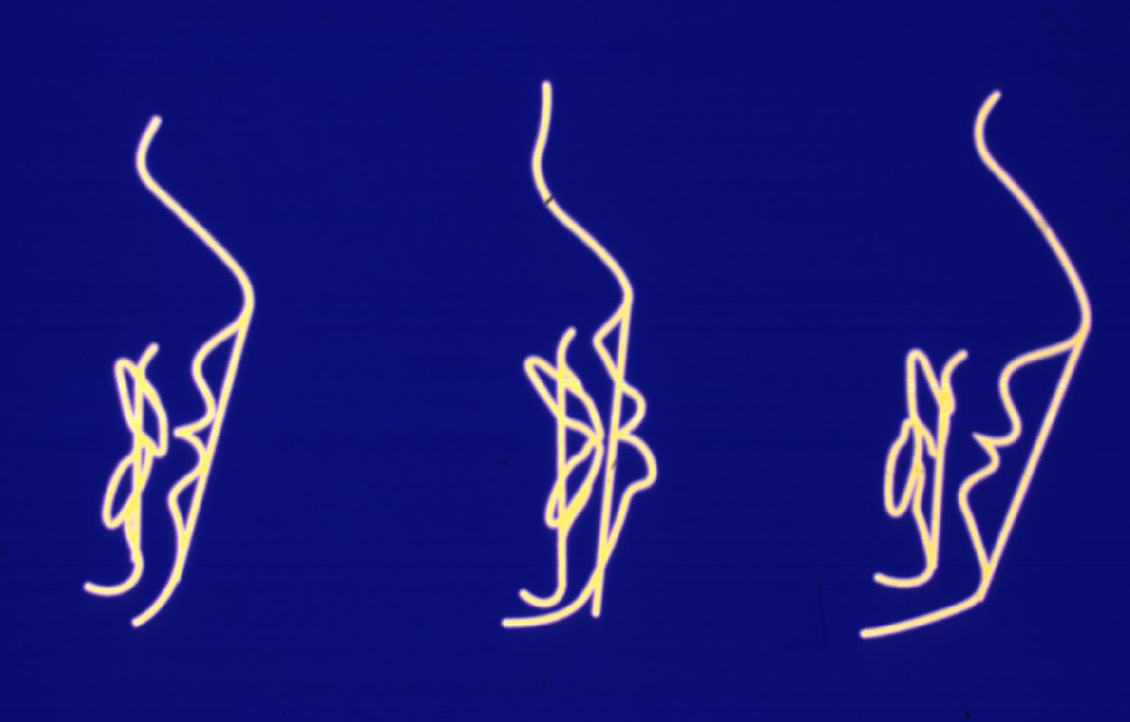
Case Selection From Facial Profile
Straight Profile Bimaxillary Protrusion Bimaxillary Retrusion

Slide 13
Case Selection From Facial Profile
Straight Profile:
Sagittal development if incisors
are retroclined and lingual to A-Po line
Bimaxillary Protrusion
Not suitable for sagittal development
Bimaxillary Retrusion
Sagittal Development is indicated

Slide 14
Class II Division 2 malocclusion
Brachyfacial - horizontal growth pattern
Low mandibular plane angle
Retroclined upper & lower incisors
Canines may be crowded buccally
Lower incisors lingual to A-Po line
Deep overbite

Slide 15
Class I Bimaxillary Retrusion
Retroclined Upper & Lower Incisors
Deep Overbite
Canines may be crowded buccally
Lower incisors displaced lingual to A-Po line
Crowding can be corrected by advancing the incisors

Slide 16
Class III malocclusion
Favourable skeletal pattern - Mild Class III
Retroclined upper incisors
Positive overbite
More severe Class III skeletal to improve
appearance by upper arch development
before surgery or as compromise treatment

Slide 17
Avoid
Inappropriate Tooth Movements

Slide 18
Guidelines
Successful treatment requires careful case selection
Avoid arch development in High FM angle cases
Anterior open bite is a contra-indication
Position lower incisors at +1 to +3mm to A-Po line
Severe crowding may require extractions

Slide 19
When proclination of incisors
is not indicated
Select the Transverse Appliance

Slide 20
In Treatment of Crowded Arches
Complete Treatment
With Fixed Appliances

Slide 21
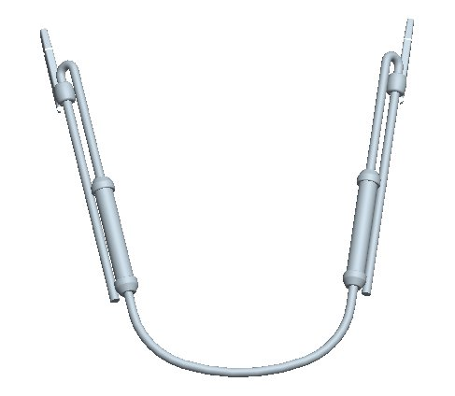
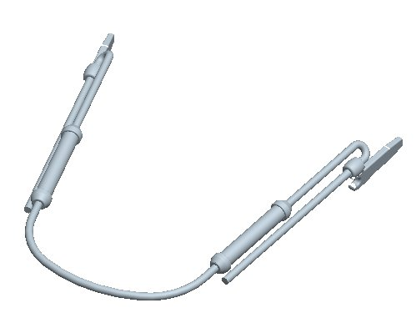
Second Generation TransForce ^{®2} Sagittal

Slide 22
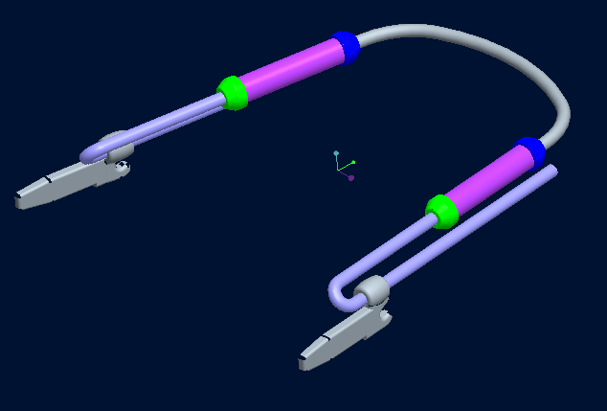
TransForce ^{®2} Sagittal
Notes:
Read Titles

Slide 23
TransForce Lingual Appliances
Available from Ortho Organizers
For further information
visit my web site:
www.transforceorthodontics.com
www.orthoorganizers.com

